Slide 1
TAIGA BIOME
SUBMITTED BY
AYESHA TANVEER
SAMRA IJAZ
SAMIA IJAZ
SADIA BASHIR

Slide 2
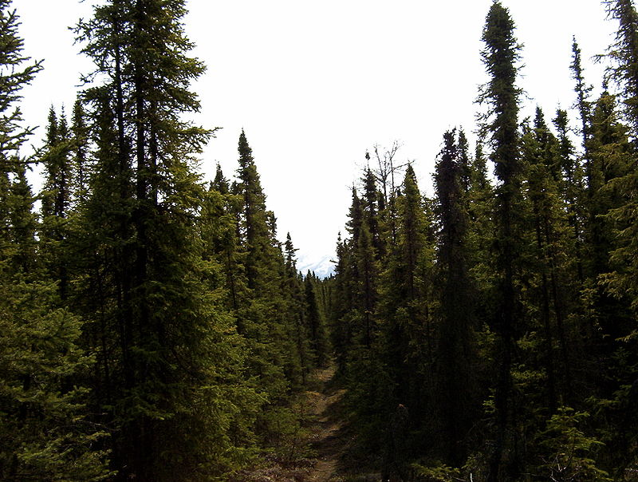
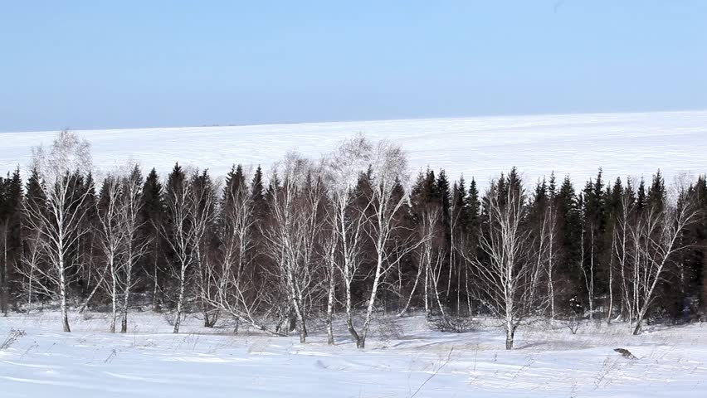
General Description
Taiga is the largest biome in the world
Taiga also known as boreal forest or snow forest, is a biome characterized by coniferous forests consisting mostly of pines, spruces and larches.
It occupies about 27% of the Earth’s surface. The forest in the taiga also makeup about 17% of earth’s vegetated land surface

Slide 3
Geographical location
The Taiga biome stretches in the Northern Hemisphere taking huge chunks of North America and Eurasia, especially Canada and Russia respectively. It also stretches in Northern Europe in countries such as Finland, Norway and Sweden and spans across Alaska and Scandinavia.
It is located south of the Tundra biome, which is characterized by a land frozen by ice and constant snow. Because of its location, the Taiga biome is fairly cold. It is to the north of the temperate deciduous forests and grasslands which are warmer. It is located above the Tropic Cancer between northern latitudes of 50° and 70°.

Slide 4
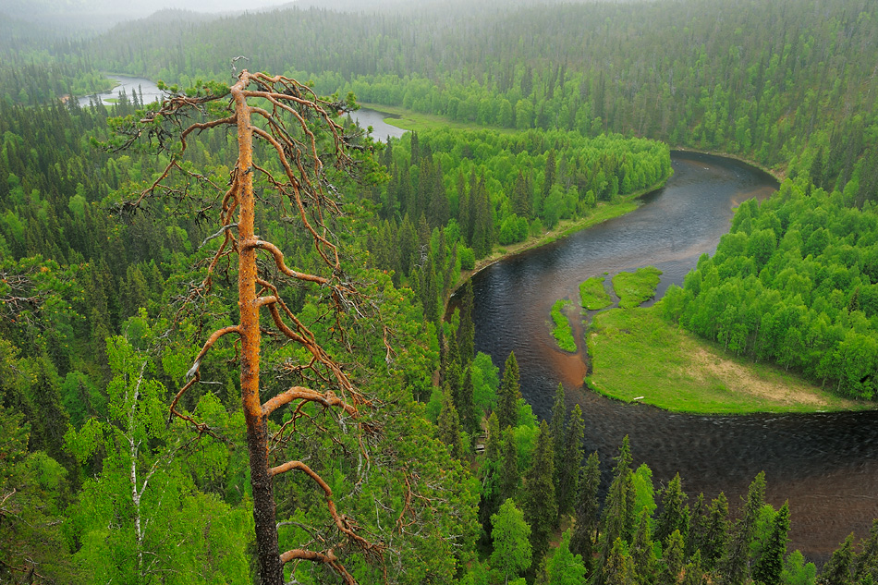
River system along Taiga biome
There are lots of rivers and river systems that span throughout the boreal forest, and they are few spots throughout the world where a boreal forest exist without supporting river.
In North America many bigger lakes are visible like Great bear lake where the boreal forest exist around Canada and Alaska. In Europe and Asia there are many bigger river systems like the Ob river in Russia, but larger lakes are fewer and far between.

Slide 5
Temperature
Limiting Factors
Taiga biome starts where the Tundra biome ends. The biome is, therefore, characterized by a lot of cold throughout most of the year. There are two major seasons, that is, winter and summer.
Typically, due to cold, the summers are short spanning about 50 to 100 days per annum with over half the year experiencing winter. Winter has temperatures as low as -54°C and as high as -1°C. As a result, during winter, there is a lot of snow falling and the land is frozen with ice.

Slide 6
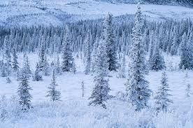
Precipitation
Precipitation in this biome takes place in both winter and summer. During winter it falls as snow while in summer it falls as rain. Dew is also a form of precipitation in this biome, though overshadowed by snow and rain. For over half a year, there is constant falling of snow with an annual height of 50-100cm. The summer season enjoys an average rainfall of 25-50cm annually bringing the average precipitation to about 75cm.

Slide 7
Soil
The soil beneath the taiga often contains permafrost—a layer of permanently frozen soil. In other areas, a layer of bedrock lies just beneath the soil.
Both permafrost and rock prevent water from draining from the top layers of soil. This creates shallow bogs known as muskegs. Muskegs can look like solid ground, because they are covered with moss, short grasses, and sometimes even trees. However, the ground is actually wet and spongy.
Taiga soil tends to be young and poor in nutrients. When needles from conifers fall on the forest floor, they decay and produce highly acidic soil. This soil makes it difficult for many taiga biome plants to thrive.

Slide 8
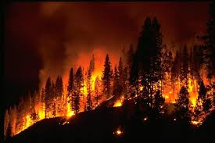
Fire
Fire is an important part of boreal forest ecosystems, occurring naturally on stand-level to landscape scales, driving physical and ecological dynamics of forest composition, structure, productivity, as well as carbon cycling and storage.
Fire is an important part of boreal forest ecosystems, occurring naturally on stand-level to landscape scales, driving physical and ecological dynamics of forest composition, structure, productivity, as well as carbon cycling and storage.
Forests in the North American boreal are more dominant in “fire embracing” species that are both spread and killed by fires.

Slide 9
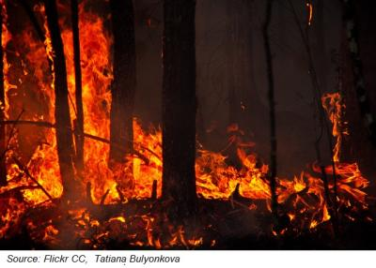
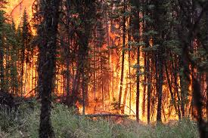
Spruces (Picea), which have flammable needles, and low-level branches that facilitate fire movement from ground level into high-intensity canopy fires, are one such species.
Eurasian boreal forests have greater numbers of fire resistant species, such as those with thick bark, larch (Larix), which has higher moisture content in its needles, and Pines (Pinus), which self-prune, eliminating the fuel ladder of low branches that turns ground-story burns into canopy fires. As a result, fires in the Eurasian boreal are predominantly surface fires, occurring with greater frequency, over smaller areas and burning dry and dead material on the forest floor.

Slide 10
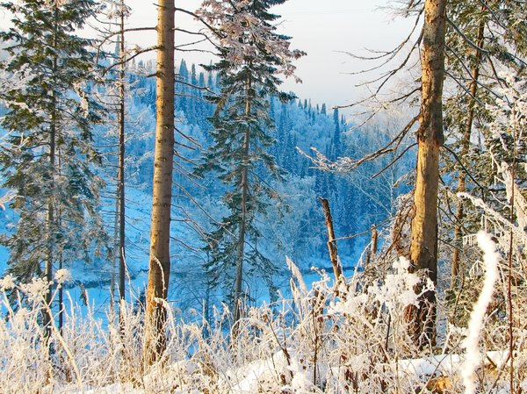
Flora
The wintery climate of the taiga makes it less diverse in plant life than many other biomes. The predominant taiga biome plants are conifers, trees that have adapted to the cold and have needles instead of leaves. In fact, the spruce, pine, fir and larch are the most common plant species in the taiga. These trees, with the exception of the larch, are evergreen, meaning they do not shed their leaves in the winter.

Slide 11
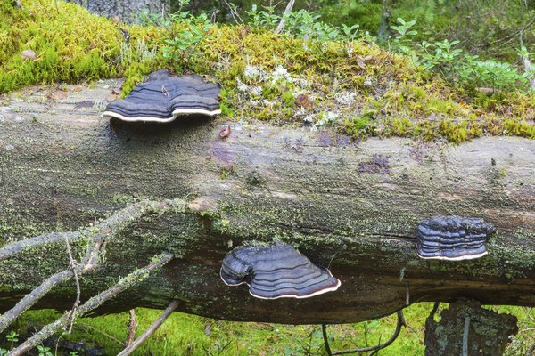
Few shrubs, such as the blueberry, and deciduous trees -- leafy trees that shed their leaves, such as oaks, birches and alders -- can be found in warmer and wetter parts of the taiga. Some plants are carnivorous; they eat insects in order to make up for the nutrients lacking in the soil. However, mosses, fungi and lichens are more common than flowers and undergrowth in heavily forested areas.

Slide 12
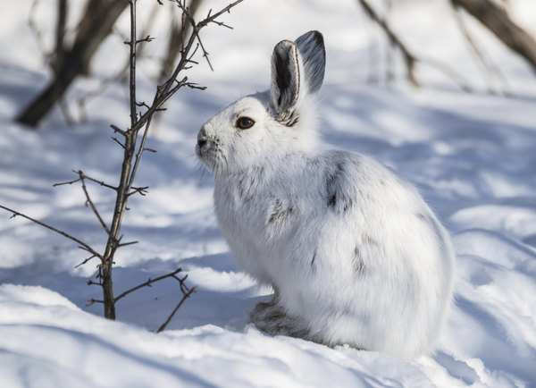
Small and Large Mammals
The wildlife of the taiga region must endure the harsh conditions of the region. Mammals, with their thick fur, are the most common form of animal life in the taiga. Frequently taiga mammals have white fur, or a white winter coat, in order to blend in with the snowy environment. Many smaller mammals, such as snowshoe hares, otters, ermines, squirrels and moles, can be found in the biome. In addition, a few larger herbivorous animals, such as moose, deer and bison, inhabit the region. Herbivorous animals either eat smaller plant life, such as shrubs, or the seeds from trees. Large predatory mammals, such as bears, lynxes and wolves -- and in Russia, the Siberian tiger -- prey on the taiga's deer and rodent populations.

Slide 13
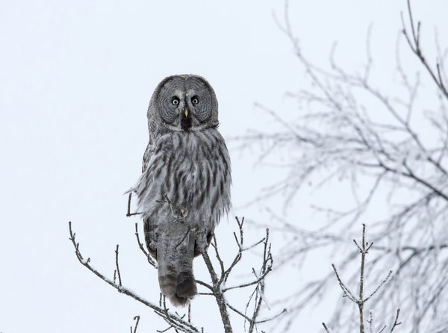
Birds of the Taiga
Most birds that live in the taiga migrate south for the winter in order to avoid the harshest cold of the region. However, during the summer months, large populations of mosquitoes and other insects provide food for species such as warblers, finches, flycatchers and woodpeckers. The small mammals of the taiga also provide an excellent food source for predatory birds. Owls and eagles feed off of voles, hares and other rodents native to the region.

Slide 15
Human Impacts
1. Deforestation
Taiga biome is in danger because of deforestation.
Humans are cutting down trees by the hundreds and slowly, the taiga is disappearing. This is obvious a negative impact on the forest as it means many animals lose their homes and are forced to move elsewhere

Slide 16
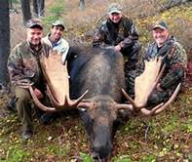
2. Hunting
Humans also, for many reasons, hunt the animals in taiga forests. Some are hunted for meat, but most are hunted as ‘prizes’.
Animals that are often hunted and have had numbers decline due to this:
Wolf
Siberian Tiger
Brown Bears
Cougar
Caribou
Moose
The most affected is the Siberian Tiger, nearly extinct since it is hunted for its coat, and then is the brown bear, whose numbers have gone down drastically. Both have a beautiful coat/pelt, making people willing to pay a lot of money to have them killed for it.

Slide 17
3. Global Warming
Extreme changes in temperature and precipitation could cause climatic zones to shift several hundred kilometres toward the poles over the next 50 years. Climatologists are also predicting that the area covered by boreal forests (the taiga) will be reduced by 50-90%.
4. Acid rain
Another problem by human influences is acid rain. Acid rain is rain that is significantly more acidic than normal rain made so by atmospheric pollution. This is a problem by human influence because the atmospheric pollution is caused by the burning of fossil fuels from factories. Acid rain is a problem for the trees because it weakens them which makes them more susceptible to disease or being damaged by the cold and insects. This affects the animals of the biome because it destroys the trees that the animals rely on for shelter and food.

Slide 18
Positive Impacts
Though humans have very drastic negative effects on the environment, there are also some positive effects. For example, people are making efforts to reduce the amount of hunting in the taiga. This ensures that the number of species in the forest does not become unbalanced and the animals can prosper. There are laws in Canada that help regulate the hunting in Canada to ensure that the animals do not become endangered.
Another positive impact of humans is that there is an effort to protect the forests as a whole. Humans see that the taiga biome is in danger and are making efforts to keep it alive and preserve it. A large group working to save the taiga is the Taiga Rescue Network made up of many NGOs and individuals. Their goal is to conserve and stop harmful consumption of the forests. They do this through educating others and researching.

Slide 19
THANKYOU

